Slide 1
Garments
Management System
Class & Collaboration Diagram
1405072
1405075
1405079
1405086
1405087
Student ID:

Slide 2
Our Sub-Systems
Account Creation
Storing Information
Order Management
Work Distribution

Slide 3
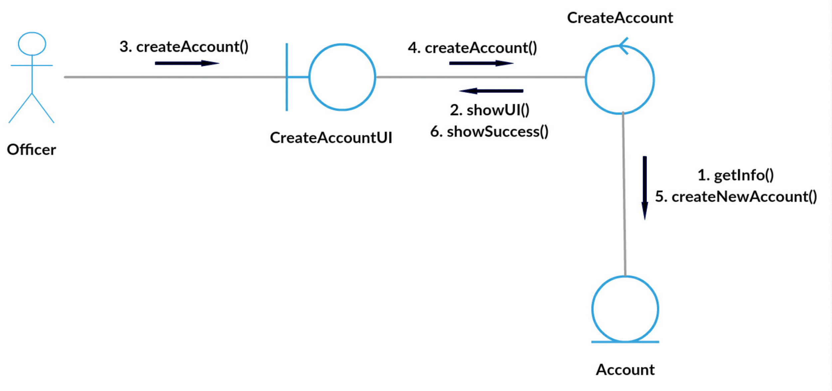
Collaboration Diagram for CreateAccount

Slide 4
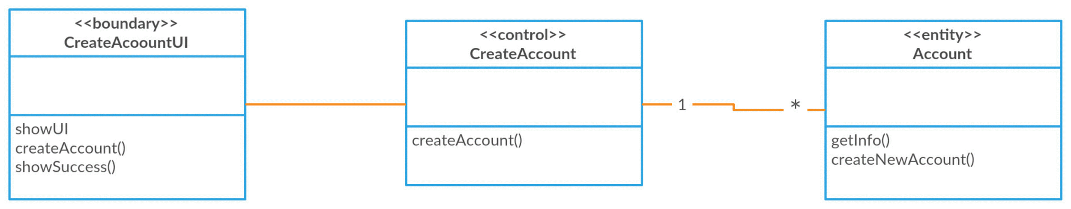
Class Diagram for CreateAccount

Slide 5
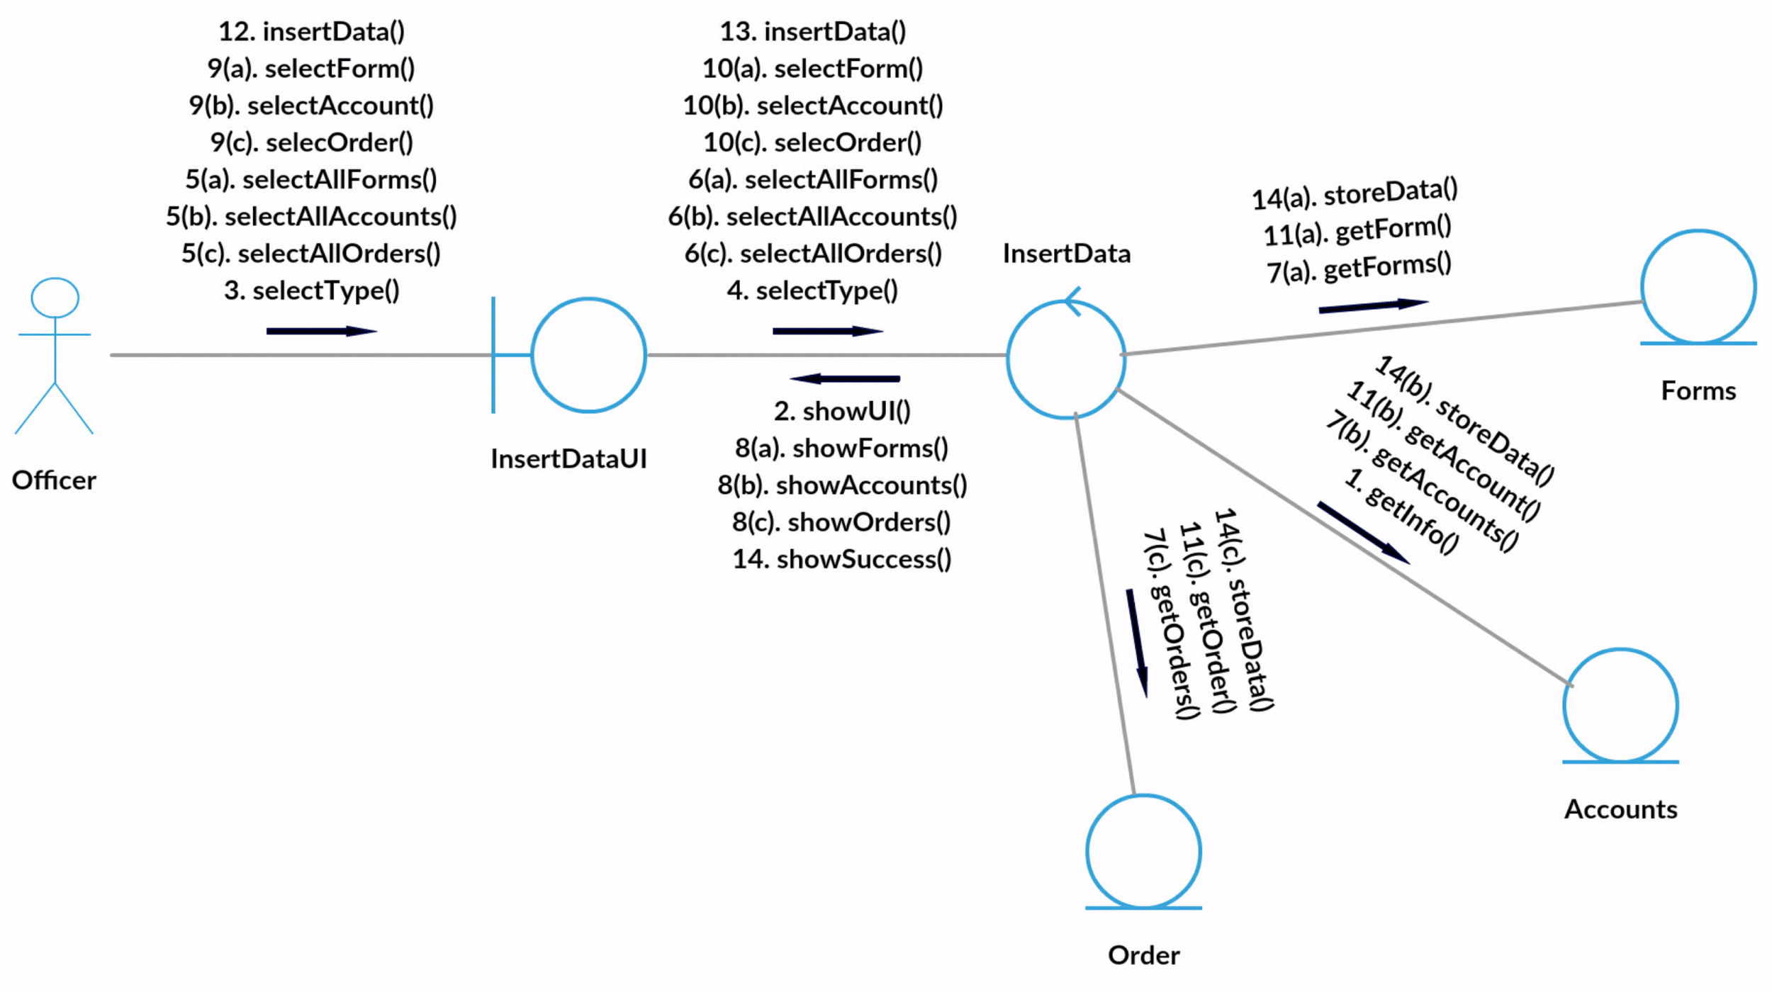
Collaboration Diagram for InsertData

Slide 6
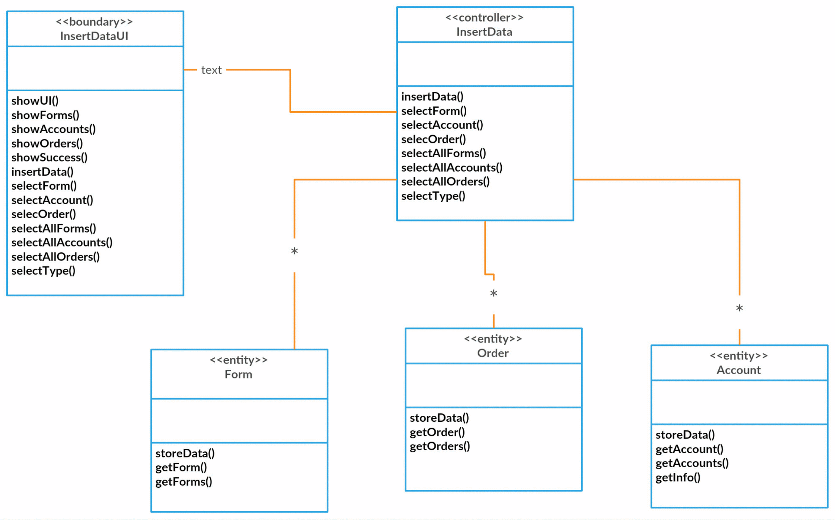
Class Diagram for InsertData

Slide 7
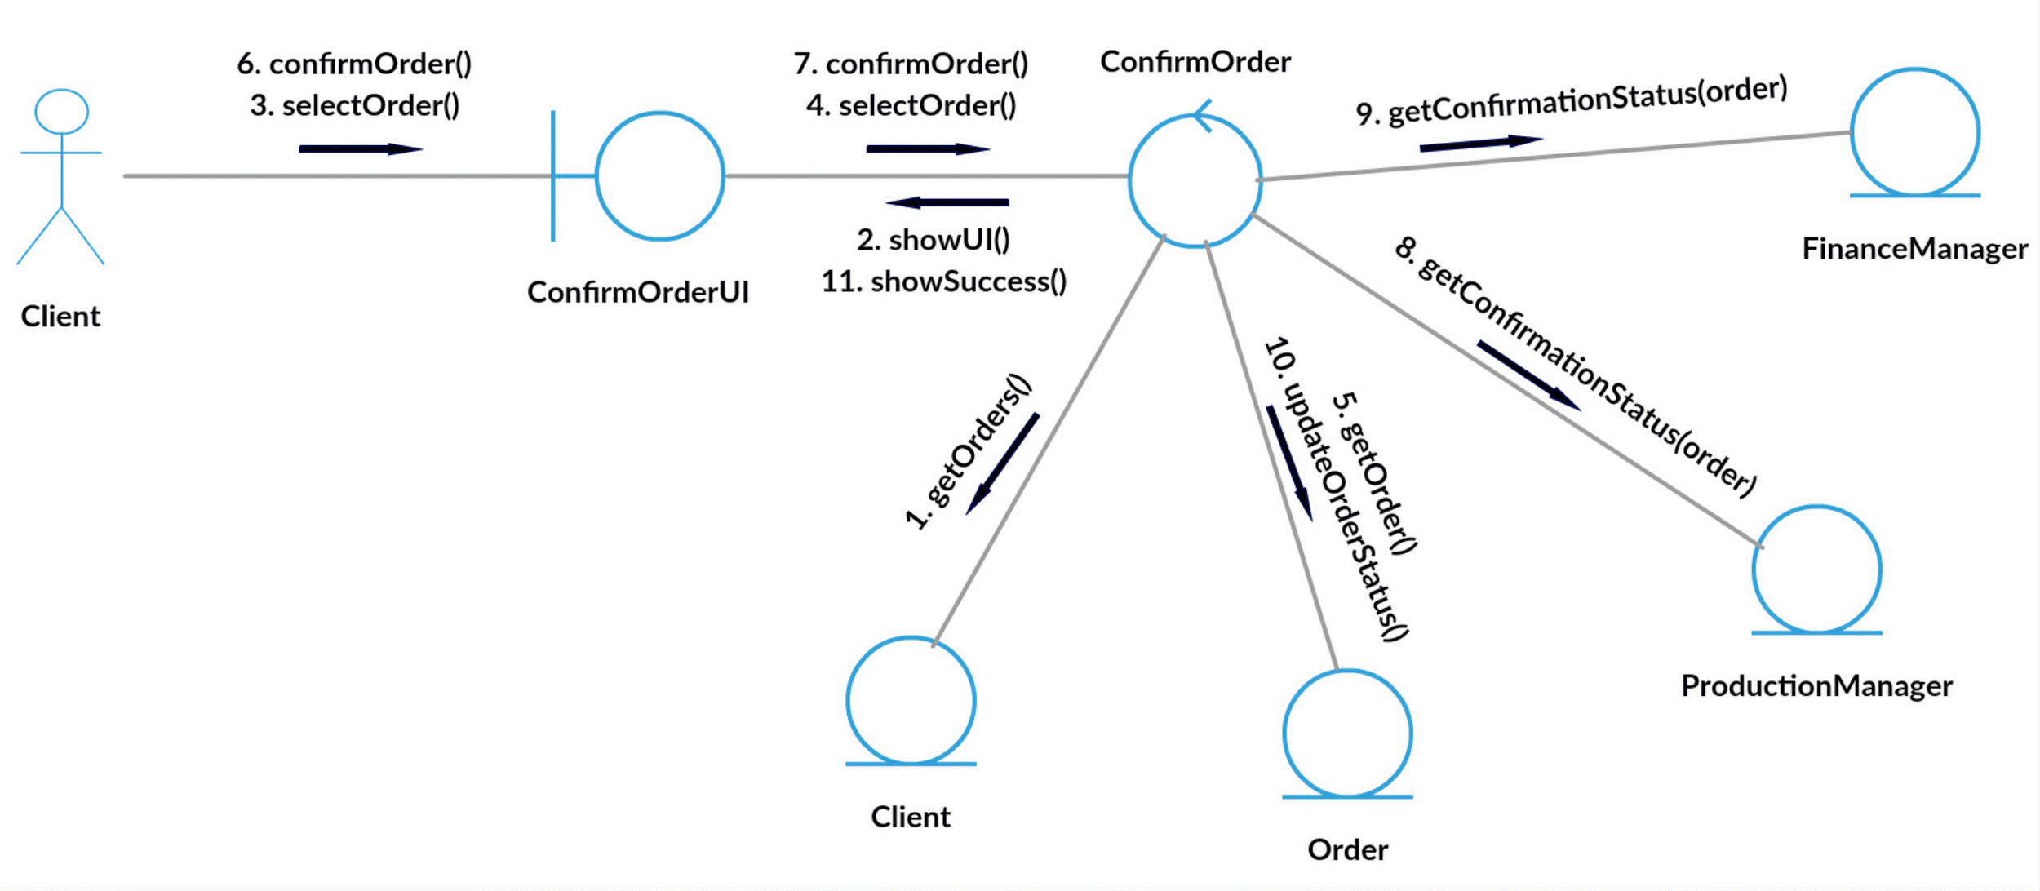
Collaboration Diagram for ConfirmOrder

Slide 8
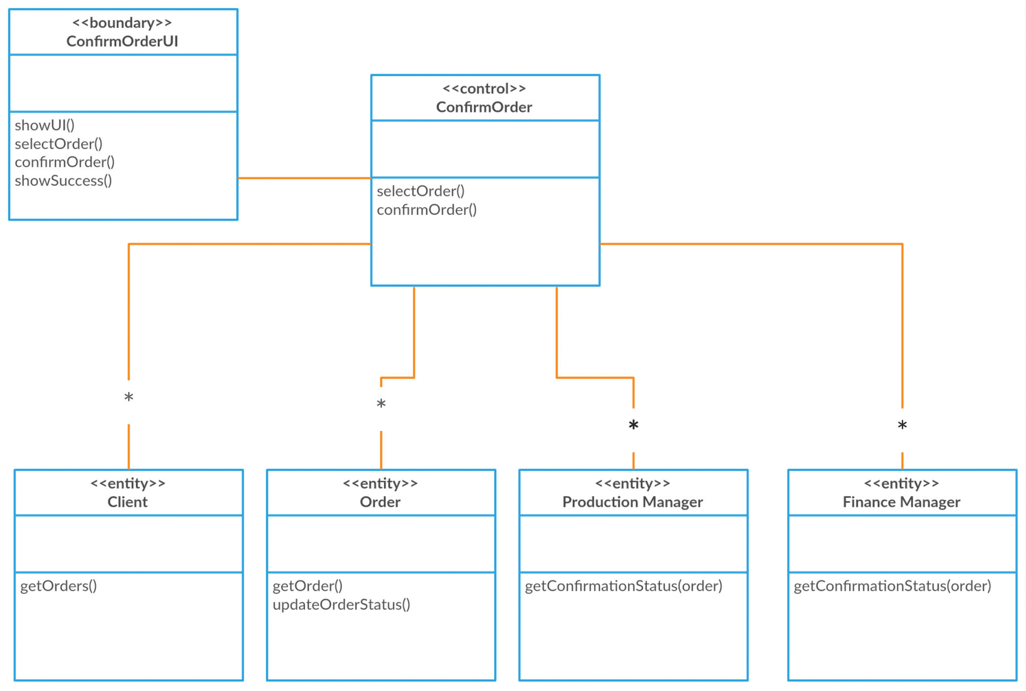
Class Diagram for ConfirmOrder

Slide 9
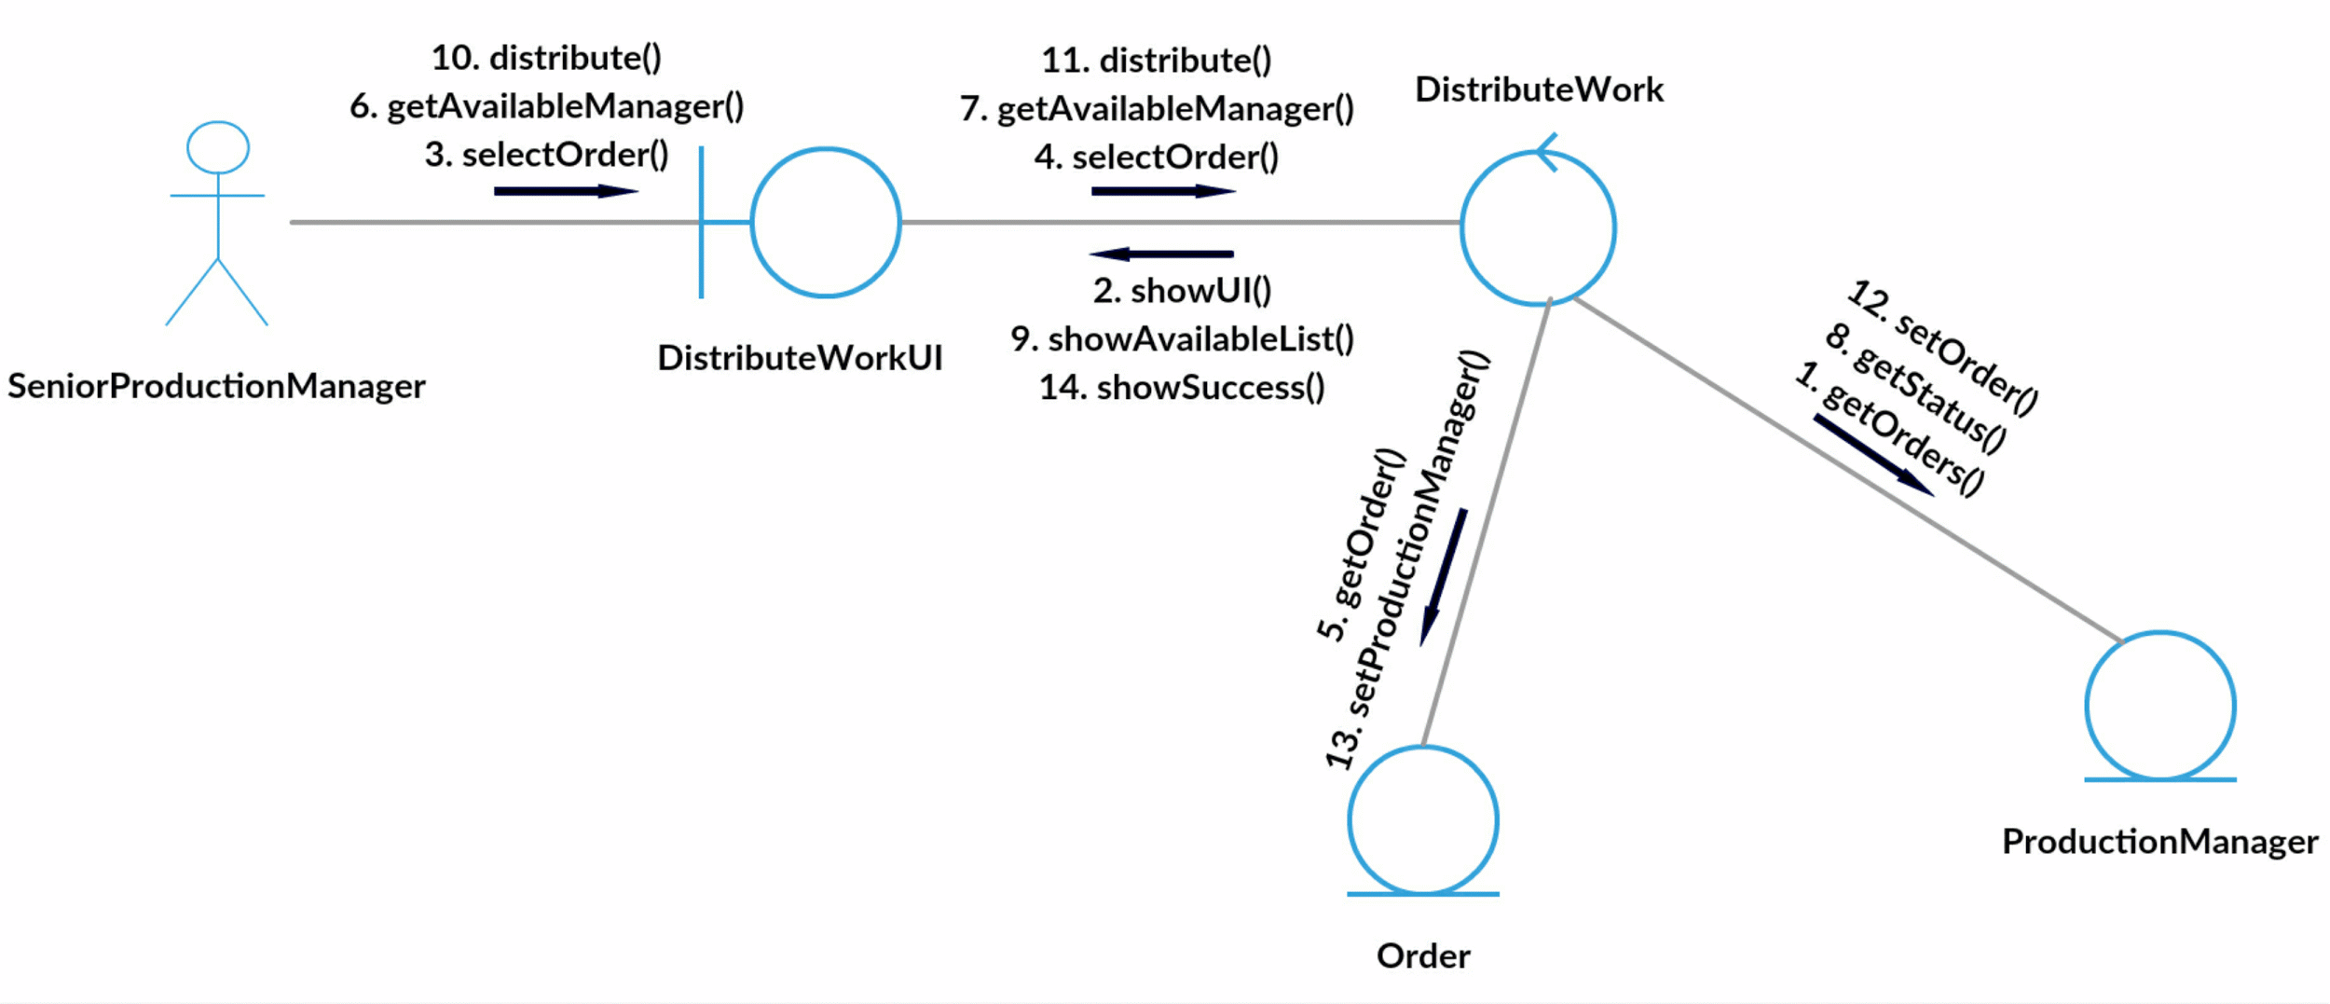
Collaboration Diagram for DistributeWork

Slide 10
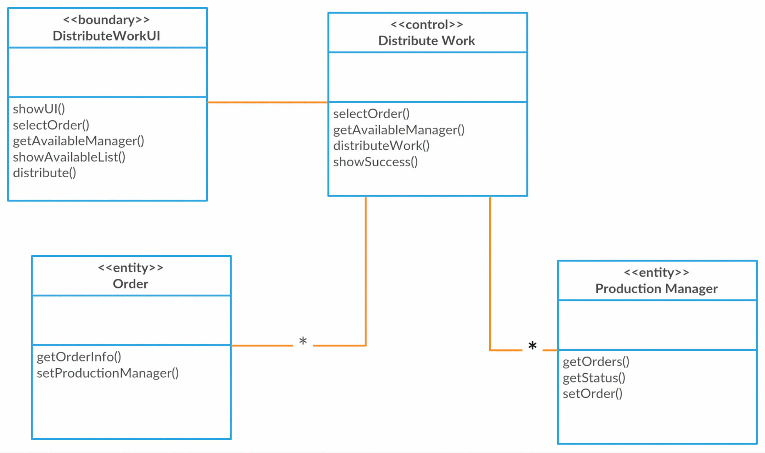
Class Diagram for DistributeWork

Slide 11
Thank you.

